Slide 1

RISK AND RESILIENCE BOOTCAMP
1

Slide 2
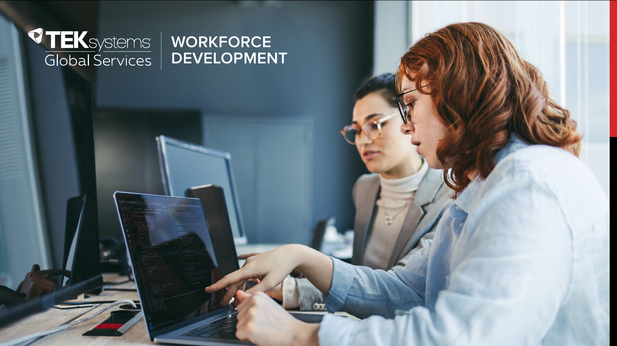

Slide 3
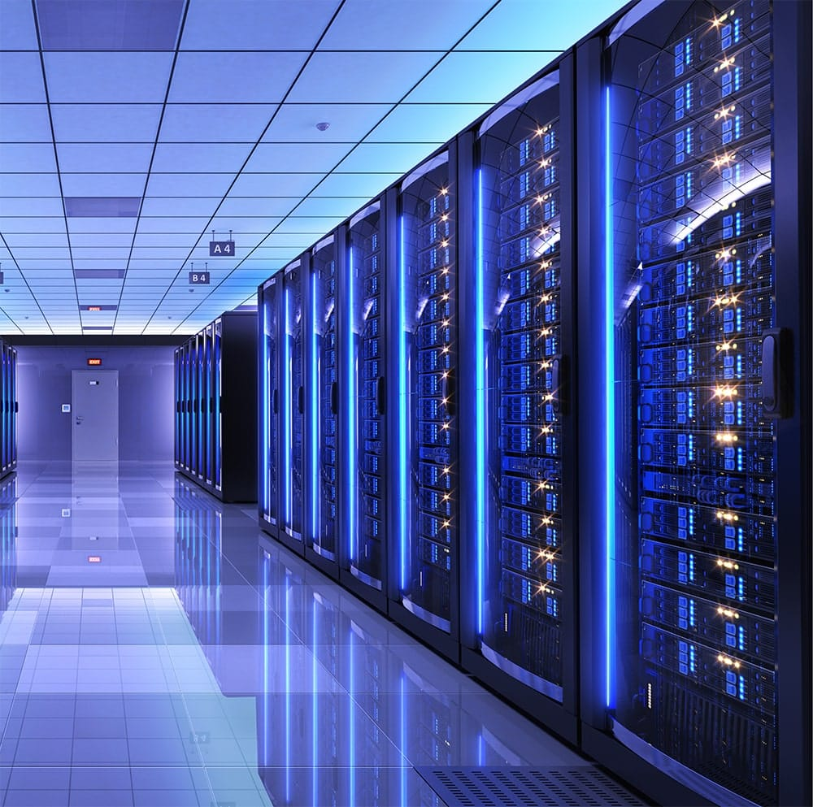
Core technology operations
In this module, we will
Examine IT infrastructure, technology and processes from a risk and resiliency perspective
Review how risk management and systems resilience deal with the challenges of technology operations
Review the role of process controls and standard operation procedures

Slide 4
introduction
The IT infrastructure and associated processes and technology tend to be sprawling and complex in most organizations
This section will look at this infrastructure from several different perspectives
This first section will include a glossary of terms
This will help clarify the discussions that follow
These are not intended to be definitive or universal definitions

Slide 5
IT Infrastructure
The collection of physical and virtual resources that support IT services and operations
Includes servers, storage, networks, databases, middleware, and cloud resources
Any other hardware or software asset used in IT operations
Potential risk/resilience issues
Legacy infrastructure is a source resilience risks due to age, vendor support limitations, or hardware dependencies
Includes existing hardware, mainframe systems, older commercial and in-house applications and software
Cloud and virtualized infrastructure introduces different categories of risk factors
For example: shared responsibility, vendor lock-in, and reliance on third-party SLAs
Vulnerabilities in infrastructure require preventive and detective controls
For example: patching gaps, misconfiguration, dependencies on obsolete components or software

Slide 6
IT Architecture
The structured design and blueprint of IT systems
Defines how infrastructure components, applications, data flows, and processes interact to support business goals
Potential risk/resilience issues
Architectural decisions (e.g, monolithic vs. microservices) influence both operational risk and resiliency strategies
Poorly documented or outdated architectures in legacy systems increase the likelihood of cascading failures and can hinder recovery plans and efforts
Risk mapping exercises often begin by analyzing the IT architecture to identify single points of failure, hidden dependencies, and integration risks

Slide 7
Application Portfolio
Applications are the business-facing layer of IT
They “sit on top” of infrastructure like servers, databases, networks, cloud resources
They are shaped by software architecture
For example: monolithic applications, microservices, client server systems, etc
Applications inherit risks from infrastructure and architecture and introduce other risks
Code quality issues: bugs, security vulnerabilities
Integration complexity: risk of cascading failures
Update and patch cycles: downtime, testing risk
Business dependency: operational or reputational risk if services are unavailable
Summary
Infrastructure = what the applications run on
Architecture = how the applications are structured and connected
Applications = the tools and services that directly deliver business value

Slide 8
Glossary Terms
Legacy Systems
Older technologies, applications, or hardware that remain in production despite being outdated or obsolete
Legacy systems are hard to patch, costly to maintain, and often rely on increasingly scarce expertise, making them high-risk in both security and resiliency
“The payroll system is a legacy platform that requires manual intervention, creating an operational risk”
Standard Operating Procedure (SOP)
Documented set of instructions detailing how to perform routine operations
SOPs reduce variability, ensure consistent controls, and support recovery under stress
Updated regularly, SOPs document the current optimal way to execute an operation
SOPs represent a knowledge base of the best practices used in the organization

Slide 9
Glossary Terms
Preventive Controls
Measures put in place to reduce the likelihood of risk events before they occur.
For example: redundancy, patch management, access controls
“Implementing multi-factor authentication is a preventive control against credential theft”
Detective Controls
Measures designed to identify and alert on risk events once they occur
For example: monitoring dashboards, SIEM alerts, intrusion detection
SIEM = Security Information and Event Management
“Log monitoring served as a detective control to catch anomalous activity”

Slide 10
Glossary Terms
Corrective Controls
Measures aimed at restoring systems to normal operation and minimizing damage after an incident
For example: backups, failover systems, hot site recovery
Often tested using testing scenarios like disaster recovery drills
Operations Monitoring
Tools and processes for observing performance, availability, and security of IT operations in real time
Monitoring is critical for both detective and preventive risk management
For example: AWS CloudWatch provides monitoring of workloads for risk indicators

Slide 11
Glossary Terms
Risk Mapping (Operations)
Identifying and charting risks across infrastructure and processes
Often using various diagrams and other analytic tools
Identifies lack of necessary controls for mitigation
For example: A risk map might highlight backup failures as a critical operational gap
Recovery Models
Structured approaches to restoring operations after an outage or disaster
Hot site, cold site, active-active clusters, cloud-based disaster recovery
Active-active clusters, for example, require two copies of the production system running at all times
An active-active recovery model provides continuous availability but is costlier

Slide 12
Glossary Terms
Business Resilience Lifecycle (BR Lifecycle)
The continuous cycle of planning, testing, executing, and improving resiliency strategies for business operations
Covers preparedness, incident response, recovery, and lessons learned
The BR lifecycle ensures lessons from incidents are fed back into preventive controls

Slide 13
It scopes or views
Development
The creation or customization of application software
In automated CI/CD environments, this also includes development of tooling
Tooling is software used to build other software, like code repositories, automated piplines
In DevOps environments, this also refers writing code to deploy virtual infrastructure
Operations
Refers to deployment, monitoring and managing of running software
Also includes the management of hardware and other infrastructure

Slide 14
Mission critical systems
Derived from the idea of mission critical software
Refers to the phenomenon of organizations becoming so dependent on software in their day-to-day operations that they cannot function if the software fails
First proposed by Grady Booch
The software runs on the IT infrastructure
Means that failures in the operations environment can also cripple the organization
Organizations cannot function without a fully operational IT infrastructure

Slide 15
Industrial strength IT
Booch pointed out that as software becomes mission critical
It starts to permeate the whole organization
As a result, it expands in size and functionality until it becomes what he calls “Industrial Strength Software”
Industrial strength software means
The code base is so large that no one individual can understand it
Often includes a lot of legacy software and systems, and their interdependencies
Applying this to operations
The running IT systems become so complex, no one individual can understand the full scope of the operational environment

Slide 16

Industrial strength IT
Mission critical software tends to have a long lifespan, and over time, many users come to depend on their proper functioning. In fact, the organization becomes so dependent on the software that it can no longer function in its absence. At this point, we can say the software has become industrial-strength.
The distinguishing characteristic of industrial strength software is that it is intensely difficult, if not impossible, for the individu­al developer to comprehend all of the subtleties of its design.
Stated in blunt terms, the complexity of such systems exceeds the human intellectual capacity. Alas, this complexity we speak of seems to be an essential property of all large software sys-­tems. By ‘essential’ we mean that we may master this complex­ity, but we can never make it go away.
Grady Booch

Slide 17
The complexity problem
As software and systems become industrial strength
They become more complex as they increase in scale
The increase in complexity is often exponential
Both from the codebase perspective and the operational perspective
Why this matters
The more complex a system is the more brittle it can become
The more complex a system is, the more prone it is to failures of various types
Complexity exposes a larger risk surface
Complexity makes it difficult to determine where to apply remediation
Complexity also makes it more difficult to recover from outages
Often because the source of the failure isn’t obvious

Slide 18
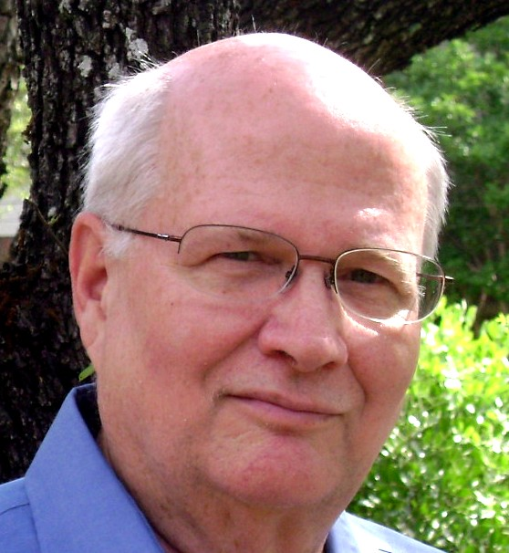
The complexity Problem
The United States is losing almost as much money per year to IT failure as it did to the [2008] financial meltdown. However the financial meltdown was presumably a one­time affair. The cost of IT failure is paid year after year, with no end in sight. These numbers are bad enough, but the news gets worse. According to the 2009 US Budget [02], the failure rate is increasing at the rate of around 15% per year.
Is there a primary cause of these IT failures? If so, what is it?.... The almost certain culprit is complexity.... Complexity seems to track nicely to system failure.
Once we understand how complex some of our systems are, we understand why they have such high failure rates.
We are not good at designing highly complex systems. That is the bad news. But we are very good at architecting simple systems. So all we need is a process for making the systems simple in the first place.
Roger Sessions

Slide 19
Scaling in Systems
Scaling is an increase in size or quantity along some dimension
Can take place in the development or operations space
Development scaling
Increase in complexity, functionality or volume of code
These dimensions are often related
Business analogy is a company increasing the range of services and products they offer or expanding into different markets (like a Canadian company expanding into Europe)
Operational scaling
Increase in the amount of activity of a system
For example: throughput, load, transaction time, simultaneous users, etc
Traditional architectures tend to be scalable only to a limited degree
There is a certain level of complexity after which they become unmaintainable

Slide 20
Managing complexity
Most of the topics in this section deal with risk and resiliency management in these large complex environments
We will break this down into the scopes we looked at earlier
Divide and conquer: development, operations, usage and governance modules
And then integrate them into a cohesive whole at the end
This module introduces two sample analytic tools
The Zachman Framework: A tool for modeling IT infrastructure and architecture
Application Lifecycle Management: An approach to modeling the lifecycle of an individual application

Slide 21
Zachman framework
Analytic tool used to understand complex business or IT systems.
Uses two-dimensional grid
The columns represent basic questions of: What, How, When, Who, Where, and Why
The rows show how these questions are realized in the architecture
Each column represents a basic question about the enterprise:
What (Things): What things are important? (e.g., data, information, objects)
How (Function): How do processes work? (e.g., functions, algorithms, workflows)
Where (Network): Where are things located? (e.g., nodes, connectivity, geography)
Who (People): Who is responsible? (e.g., roles, org structure, accountability)
When (Time): When do events happen? (e.g., schedules, timing, cycles)
Why (Motivation): Why are we doing this? (e.g., goals, rules, strategy)

Slide 22
Zachman framework
Each row answers the column’s question from a different stakeholder’s view, moving from abstract to concrete
Each row reifies or makes more concrete the row above it
The rows are:
Scope (Planner’s View): High-level context (e.g., business goals, external environment)
Business (Owner’s View): Business perspective (e.g., what the business cares about)
System (Designer’s View): Conceptual system design
Technology (Builder’s View): Logical technology design
Detailed (Implementer’s View): Physical design and configuration
Working (User’s View): Actual running system in operation

Slide 23
Zachman framework
Reification = moving down the rows
Reification is the process of making an abstract concept more concrete as you move down the rows
Example:
Consider the “what” or data column
Identification (Scope): “We need to track customers”
Definition (Business): “Customer = person with an account”
Representation (System): “Customer entity in ERD diagram”
Specification (Technology): “Customer table schema in database”
Configuration (Detailed): “Configured database table with defined fields”
Instantiation (Working): “Running production database with real customer records”

Slide 24
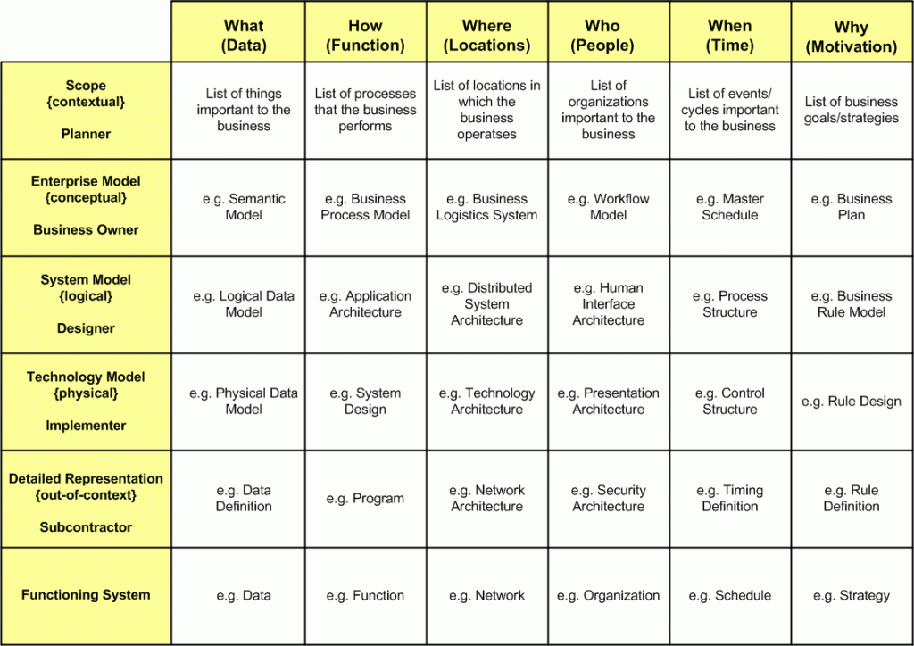
Zachman framework

Slide 25
Zachman framework
Application to risk and resilience
Risks exist at all levels:
Abstract
For example: unclear business goals introduces the risk of misalignment
Concrete
For example: poor database backup introduces operational risk
Controls map across rows:
Preventive: high-level standards, policies
Detective: monitoring at system level
Corrective: recovery at implementation level
The Zachman rows + reification help ensure no blind spots in risk analysis
Clarifies how operational systems support higher level functions
Assists in developing business impact analysis

Slide 26
Other frameworks
There are a number of similar frameworks
Many of these are used for risk management
Again, the primary focus has been cybersecurity
TOGAF (The Open Group Architecture Framework)
Origin: Developed by The Open Group
Focus: A step-by-step methodology (Architecture Development Method, ADM) for developing and managing enterprise architectures
Strength: Process-driven, widely adopted in industry, has certifications
Relation to Zachman: Where Zachman is a taxonomy (classification scheme), TOGAF provides a process to build architecture. They are often used together

Slide 27
Other frameworks
FEAF (Federal Enterprise Architecture Framework)
Origin: Developed by the U.S. Federal CIO Council
Focus: Standardized approach for U.S. government agencies to align IT with business goals
Strength: Provides reference models (Performance, Business, Service, Data, Technical)
Relation to Zachman: Like Zachman, it provides structured “views” of architecture, but is tailored to compliance and governance in public sector

Slide 28
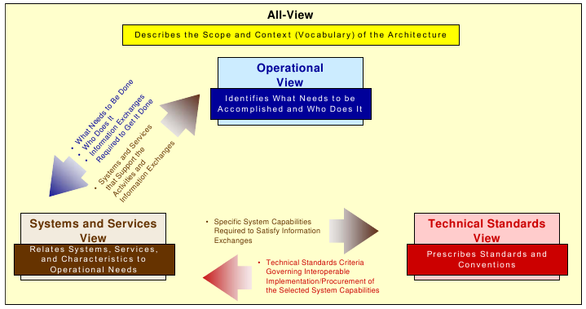
Other frameworks
DoDAF (Department of Defense Architecture Framework)
Origin: U.S. Department of Defense.
Focus: Architectural views for defense systems; emphasizes operational, system, and technical standards
Strength: Highly structured, supports complex mission systems, risk management, and interoperability
Relation to Zachman: Similar multi-view approach but specialized for defense/resiliency contexts

Slide 29
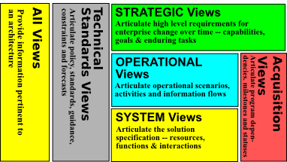
Other frameworks
MODAF (Ministry of Defence Architecture Framework)
Origin: UK Ministry of Defence (similar to DoDAF)
Focus: Defense enterprise architecture, interoperability, and mission resiliency
Strength: Structured views and models, later influenced international standards
Relation to Zachman: Zachman’s conceptual rigor influenced its grid-style structuring

Slide 30
Other frameworks
ISO/IEC/IEEE 42010 (Standard for Architecture Description)
Origin: Joint ISO/IEC/IEEE standard
Focus: Provides a standard way to describe architectures with viewpoints, stakeholders, concerns
Strength: Internationally recognized; focuses on architecture descriptions rather than processes
Relation to Zachman: Shares the idea of viewpoints and stakeholder perspectives as in Zachman’s rows and columns

Slide 31
Application lifecycle management
ALM analyzes software as a product with a lifecycle, not just code to be delivered once
It integrates three continuous streams:
Governance: oversight, compliance, risk management, business alignment
Development: building, enhancing, testing, and integrating the software
Operations: running, monitoring, supporting, and maintaining the application in production
These streams span across the major milestones of an application’s lifetime:
Initiation: concept, business case, requirements, governance setup
Deployment: release into production and ongoing updates
Retirement: phasing out, migrating data, decommissioning

Slide 32
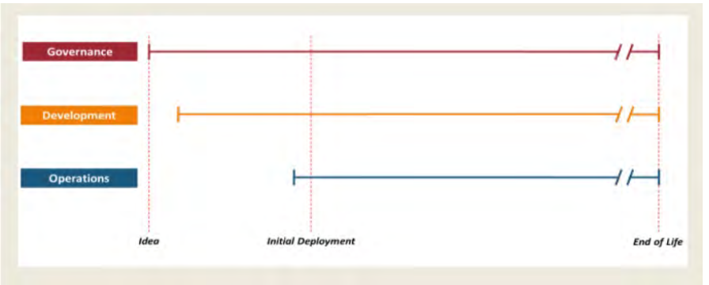
Application lifecycle management

Slide 33
The Three Streams of ALM
Governance
Ensures the application aligns with business goals, compliance, and risk appetite
Defines policies for security, resiliency, quality standards, and regulatory adherence
Weak governance means resilience goals (e.g., recovery time, data protection) may never get built into requirements
Development
Covers design, coding, testing, integration, and continuous delivery
Evolves applications over time, introducing features and bug fixes
Poor development discipline creates technical debt, security flaws, and fragile code and increasing resilience risk

Slide 34
The Three Streams of ALM
Operations
Runs the software in real-world environments with monitoring, support, and maintenance
Focused on uptime, stability, patching, and performance
Operational blind spots (e.g., weak monitoring, poor incident response) lead to prolonged outages
How ALM supports risk and resilience
Governance: Ensures that resilience goals (uptime, compliance, recovery models) are part of strategy from day one
Development: Embeds resilience into code (error handling, modular design, secure development)
Operations: Delivers resilience in practice (monitoring, failover, recovery, incident response)
Milestones: Provide checkpoints where risk can be assessed and controls adjusted

Slide 35
Lifecycle Milestones
Initiation: start of life
Business case approved, governance structure established, resilience requirements set (e.g., uptime, recovery objectives)
Risk if skipped:
Misalignment with business continuity; resilience needs bolted on later instead of designed in
Deployment: operational life
Application released and evolves under DevOps / CI/CD processes
Operations ensure stability while governance checks compliance and risk exposure
Risk if weak:
Frequent outages, compliance failures, missed SLAs

Slide 36
Lifecycle Milestones
Retirement: end of life
Application decommissioned with data migrated, dependencies untangled, and security risks removed
Risk if ignored:
Legacy risk persists: “zombie apps” still running unsupported, exposing the enterprise to resilience failures
Zachman and ALM
Zachman shows views of architecture
ALM shows the lifecycle of applications
Together they help identify risk and resilience issues across time and across system dimensions

Slide 37
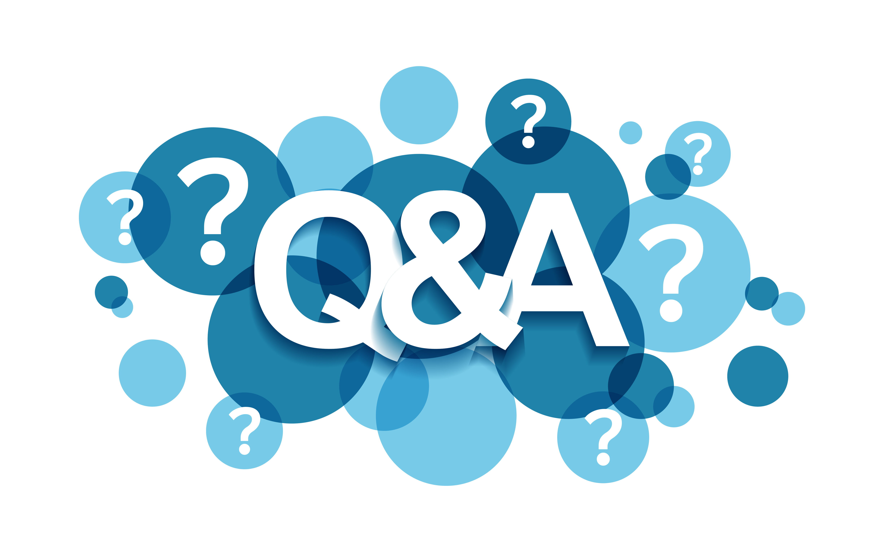
Q&A and open discussion

